Slide 1
ENPM 661 PROJECT PRESENTATION - GROUP 4
1. Abhishek Avhad - 120257162
2. Gautam Sreenarayanan Nair - 119543092
3. Piyush Goenka - 120189500

Slide 2
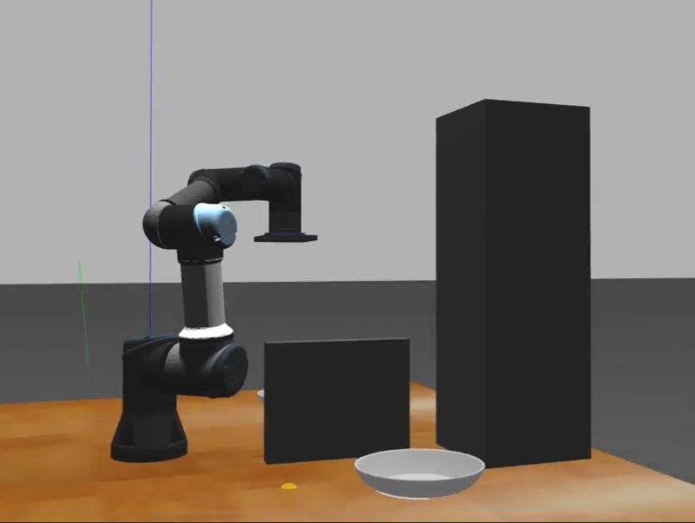
IMPLEMENTATION OF ​3D RRT STAR BIASED ALGORITHM ON UR3
CONTENT:
INTRODUCTION
APPROACH
ALGORITHM EXPLANATION
COMAPRITIVE STUDY
SIMULATION
RESULTS
CHALLENGES FACED & FUTURE WORK
CONCLUSION
GROUP NO. 4

Slide 3
INTRODUCTION
Possible Planning Algorithms
1. Graph-based grid searches
2. Discretizing the state space through random sampling
3. Cell Decomposition Algorithms
4. Multi-Agent Algorithms
GROUP NO. 4

Slide 4
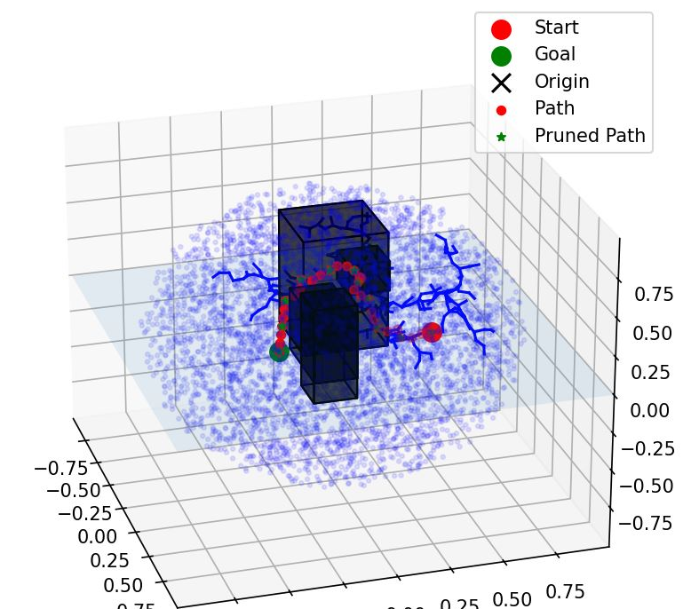
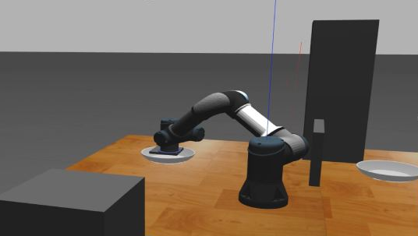
Approach
GROUP NO. 4

Slide 5
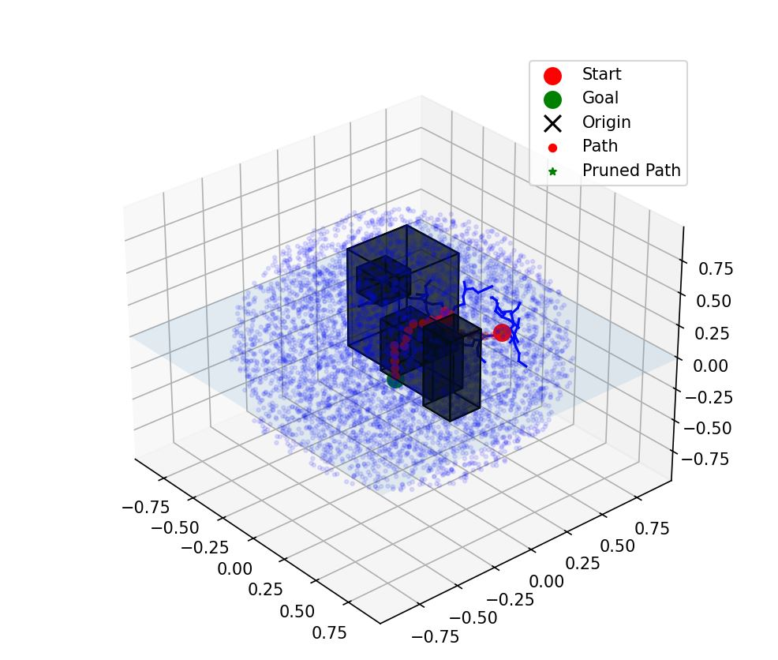
Algorithm EXPLANATION
Step 1: Initialization:
Start with an empty tree T consisting of only the initial state as the root node. Add the initial state to the tree.
Step 2: Expansion:
Repeat until a termination condition is met (e.g., maximum number of iterations or reaching a time limit):
Generate a random state q_rand in the state space.
Bias the selection of q_near to favor nodes closer to the goal. This biasing can be achieved through various techniques, such as sampling more frequently from a region around the goal.
Find the nearest node q_near in the tree T to the randomly sampled state q_rand.
Extend the tree towards the randomly sampled state by applying a steering function to generate a new state q_new. This function ensures that the generated state is feasible and moves towards q_rand while avoiding obstacles.
If q_new is collision-free, add it to the tree T and connect it to q_near with a path segment. Update the parent of q_new to q_near.
Optionally, improve the cost of the path to q_new by rewiring the tree if q_new improves the cost of existing paths.

Slide 6
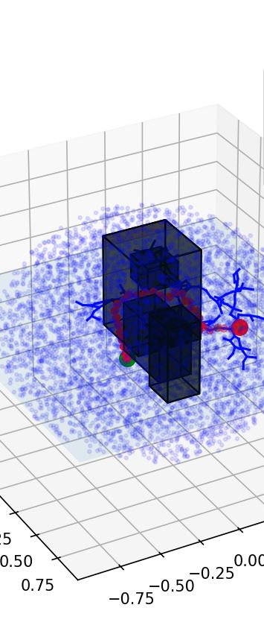
Algorithm EXPLANATION
Step 3: Rewiring:
After adding a new node to the tree, consider rewiring the tree to improve the cost of existing paths.
For each node q_new in the tree:
Find nearby nodes within a certain radius around q_new.
For each nearby node q_near:
Check if connecting q_new to q_near creates a lower-cost path compared to its current parent. If so, update the parent of q_near to q_new.
Step 4: Path Reconstruction:
After termination, reconstruct the near-optimal path from the initial state to the goal by tracing back from the goal node through the parent pointers in the tree.
GROUP NO. 4

Slide 7
Comparative Study
Metrics | RRT | RRT STAR BIASED
Algorithm Overview | RRT constructs a tree structure by iteratively expanding the search space from a starting configuration towards the goal configuration using random samples and connecting them to the nearest nodes in the tree. | RRT* Biased is an extension of RRT that aims to improve the optimality of the solution by iteratively rewiring the tree structure to find lower-cost paths. It maintains the basic structure of RRT star but includes a further goal bias to improve the solution quality.
Optimality | Generally, RRT does not guarantee optimality in finding the solution. It may find a feasible path to the goal, but it may not be the optimal one. | RRT* Biased is designed to asymptotically converge to the optimal solution as the number of iterations increases. It continuously improves the tree structure to find better paths, resulting in potentially more optimal solutions compared to RRT.
Computational Complexity | RRT has lower computational complexity compared to RRT* because it does not involve the additional step of rewiring the tree structure. | RRT* Biased has higher computational complexity due to its rewiring mechanism, which involves evaluating and updating the cost of paths and potentially reorganizing the tree structure.
GROUP NO. 4

Slide 8
Comparative Study
Metric | RRT | RRT STAR BIASED
Robustness | RRT may struggle in scenarios with complex or narrow spaces where the exploration is inefficient, leading to suboptimal paths. | RRT* Biased is more robust in such scenarios due to its ability to continuously refine the tree structure, leading to better exploration of the search space and potentially finding more optimal paths.
Application | RRT is suitable for applications, where finding a feasible path quickly is more important than optimality, such as real-time motion planning for robots or video game AI. | RRT* Biased is more suitable for applications where optimality is critical, such as autonomous navigation in safety-critical environments or robotic systems where efficiency is essential.
VISUAL REPRESENTATION VIDEO LINKS
RRT: https://youtu.be/YYwdC_GXb7Q?si=FWUB2oXMoXYO69I6
RRT STAR BIASED: https://youtu.be/B2dtDf0w5ew
GROUP NO. 4

Slide 9
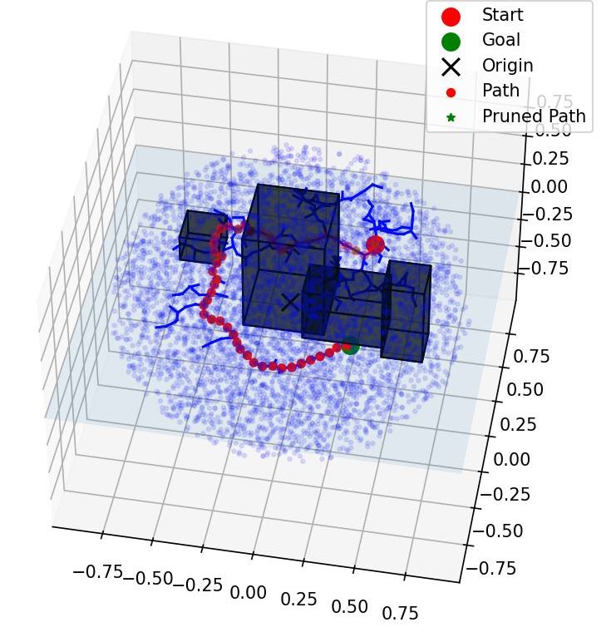
RRT (biased) vs RRT STAR (biased) RESULTS
Path 1 : Around the obstacle
Path 2 : Over the obstacle
GROUP NO. 4

Slide 10
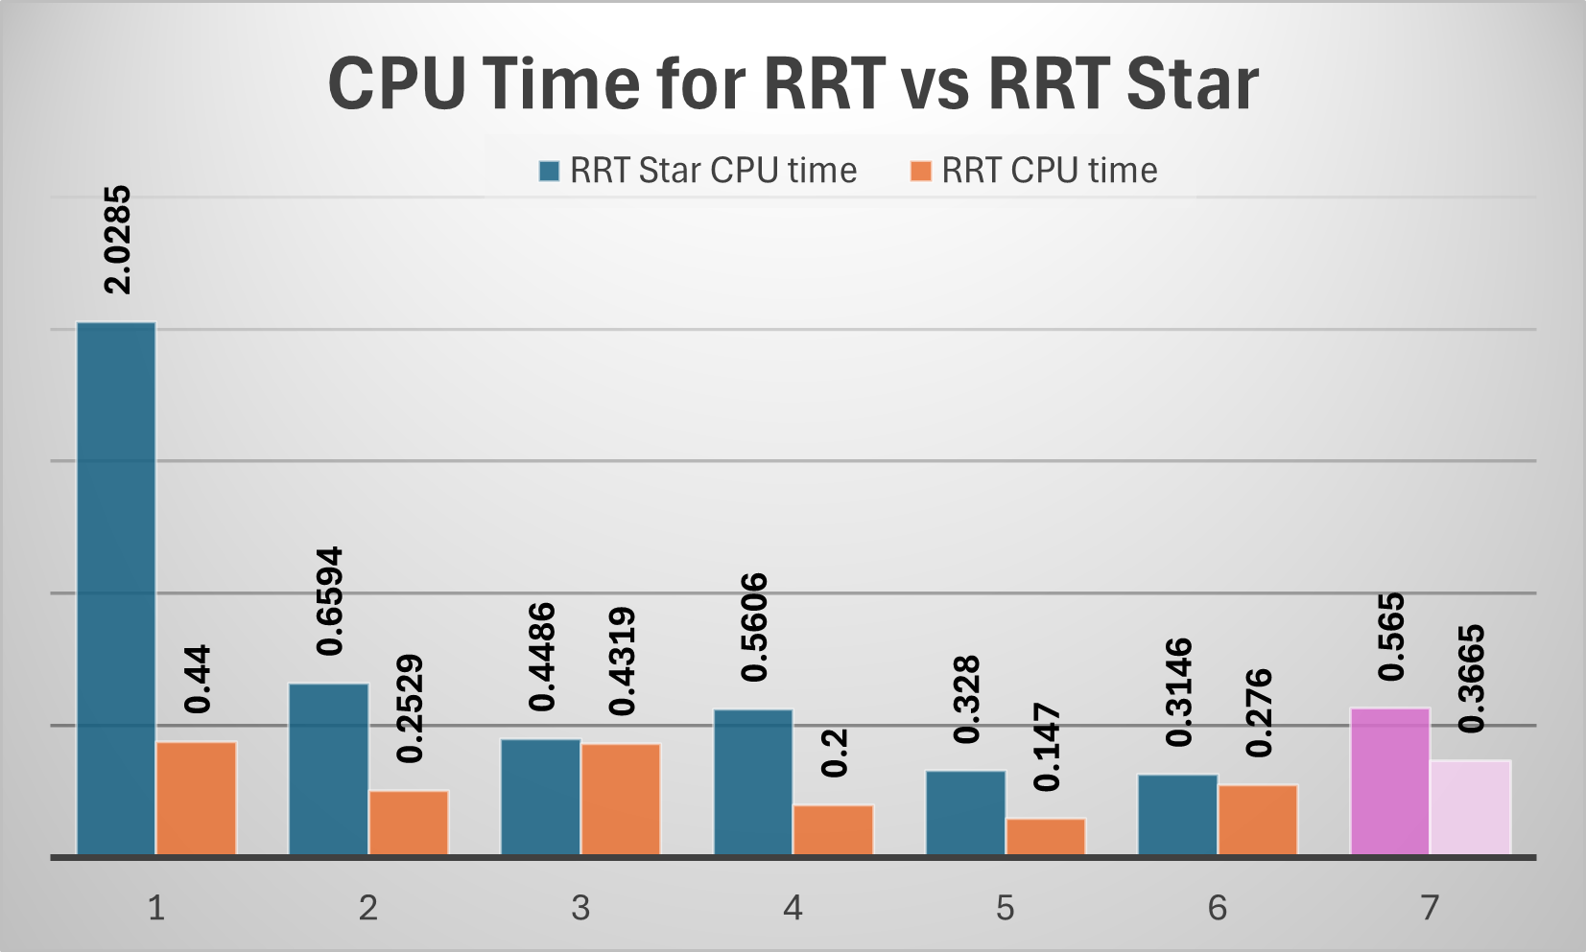
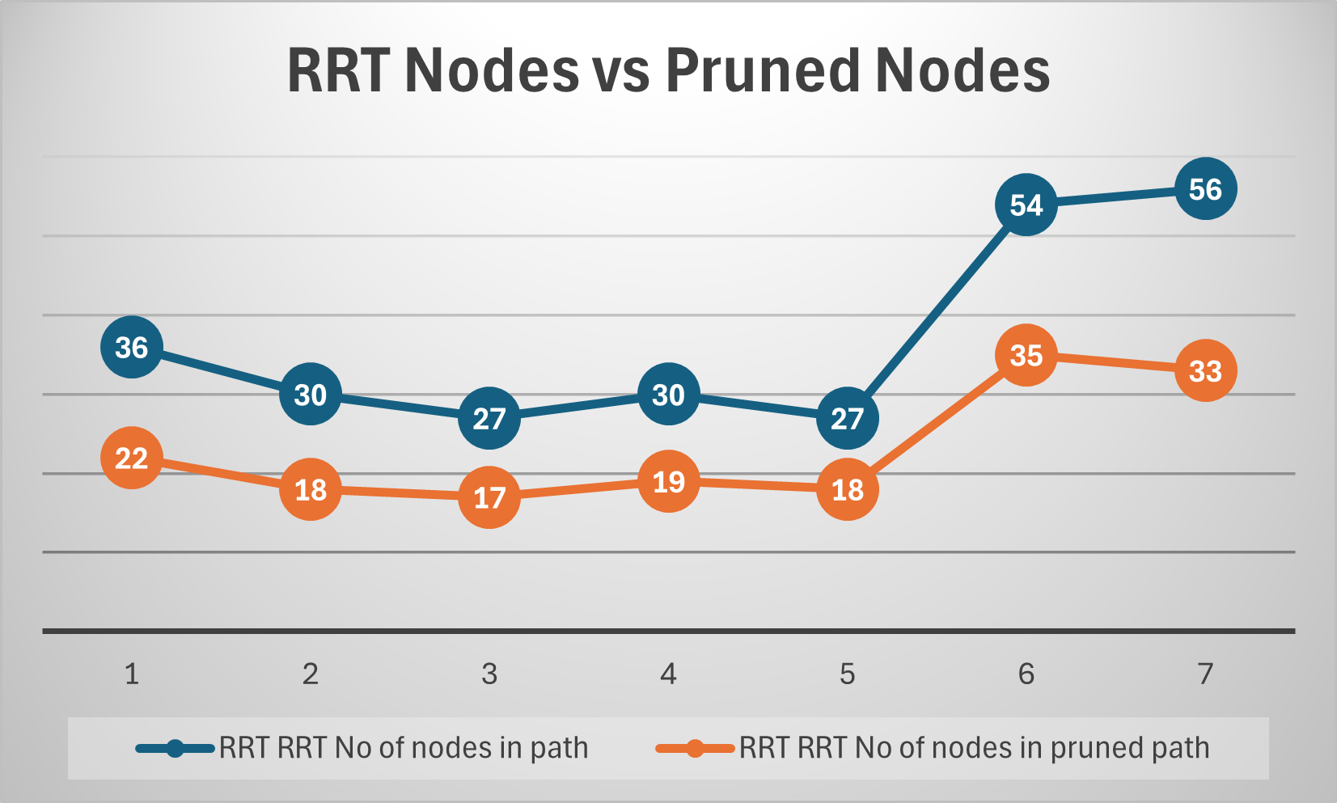
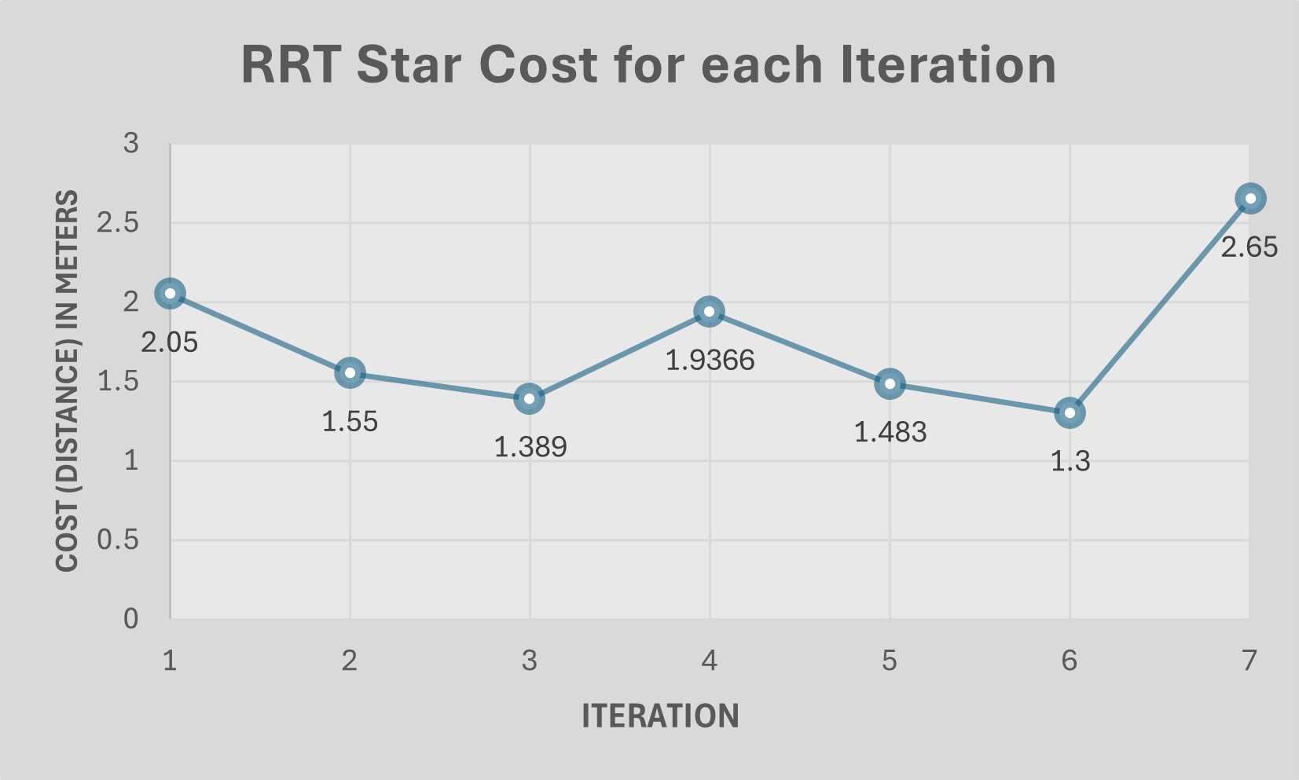
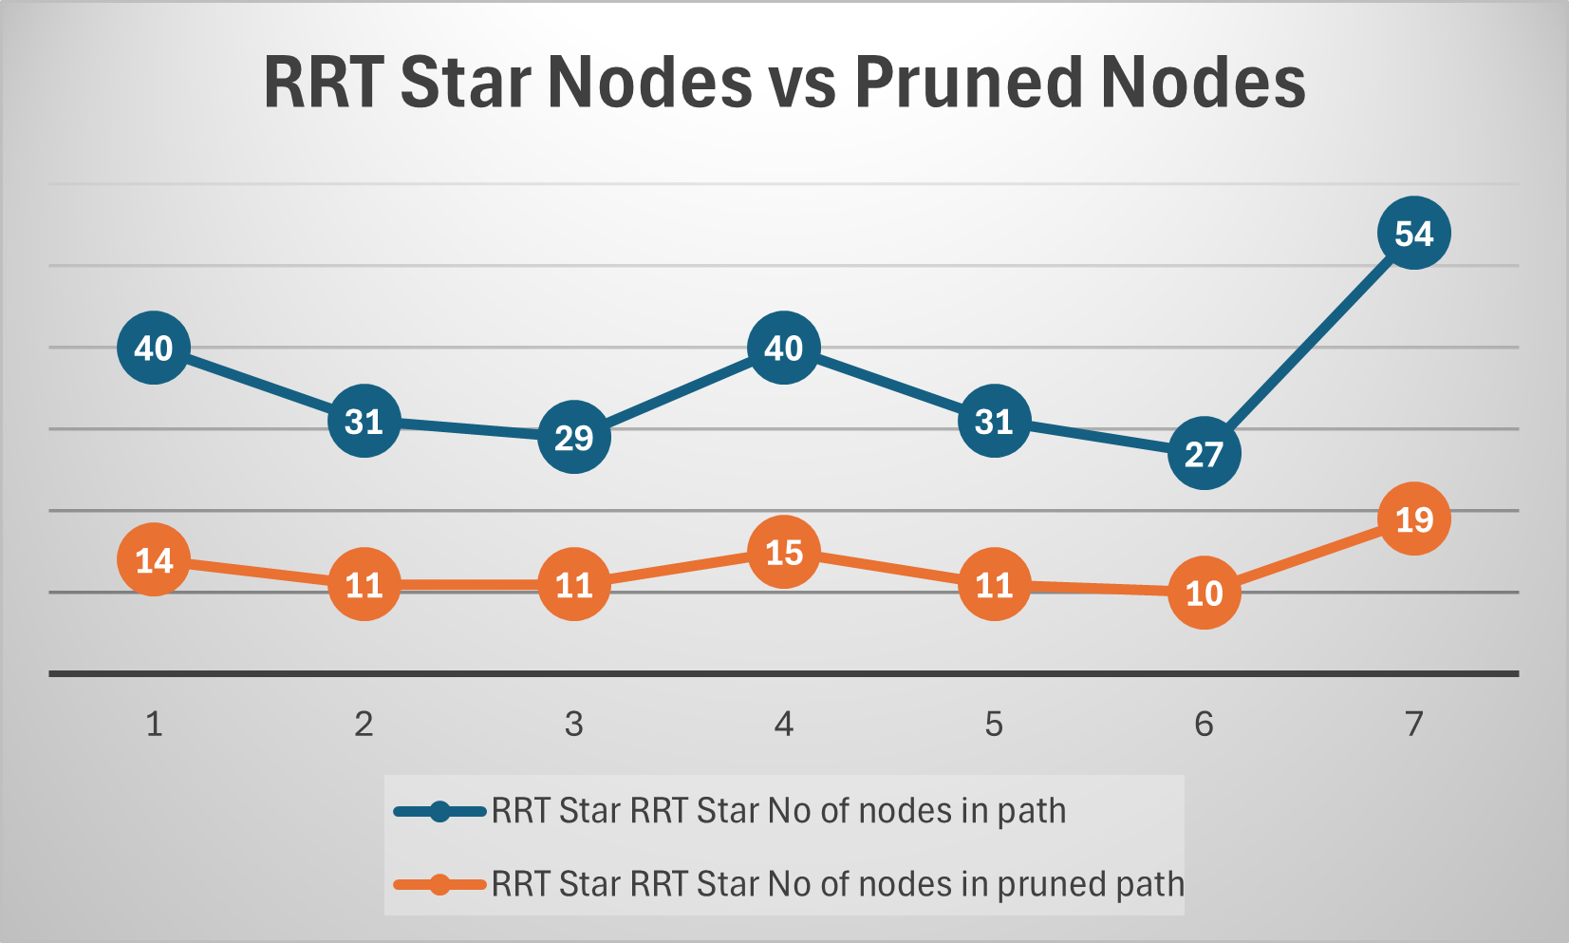
RRT (biased) vs RRT STAR (biased) RESULTS
GROUP NO. 4

Slide 11

SIMULATION SETUP
ROS2 Architecture
Planner Controller Node
RRT Star based Path planner
A callback timer with Flags for State control
Moveit Server
Waypoints
Success/Fail
On / Off
Vacuum gripper Client
Success/Fail
UR3e
GROUP NO. 4

Slide 12
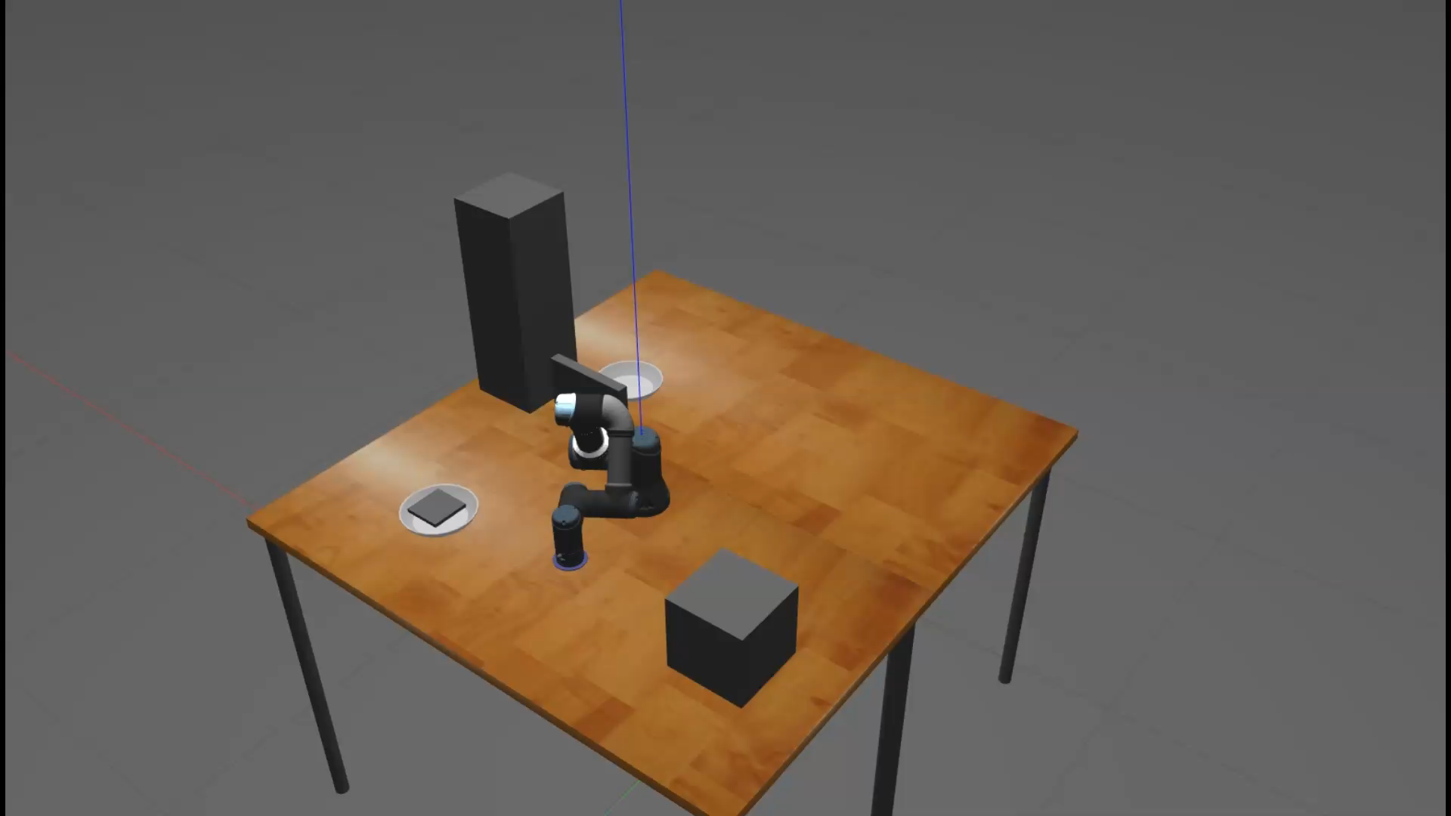
SIMULATION VIDEO
Simulation Video Link: https://youtu.be/UKlIfcn6nj0

Slide 13
Problems TACKLED & Future work
PROBLEMS TACKLED
Kinematic constraints: Ensuring RRT* generates valid paths respecting UR3's joint limits and velocity constraints.
Collision avoidance: RRT* must generate collision-free paths in UR3's workspace.
Real-time performance: Minimizing RRT*'s path-planning time for timely responses.
Path optimization: Balancing efficiency and smoothness through additional optimization post RRT* planning.
CONCLUSION
In conclusion, we successfully generated efficient path for UR3e motion in 3D obstacle space.
FUTURE WORK
We plan to implement the algorithm in real world UR3, with more optimized variant of RRT star, i.e Informed RRT star.
GROUP NO. 4

Slide 14
THANK YOU
GROUP NO. 4

